Slide 1
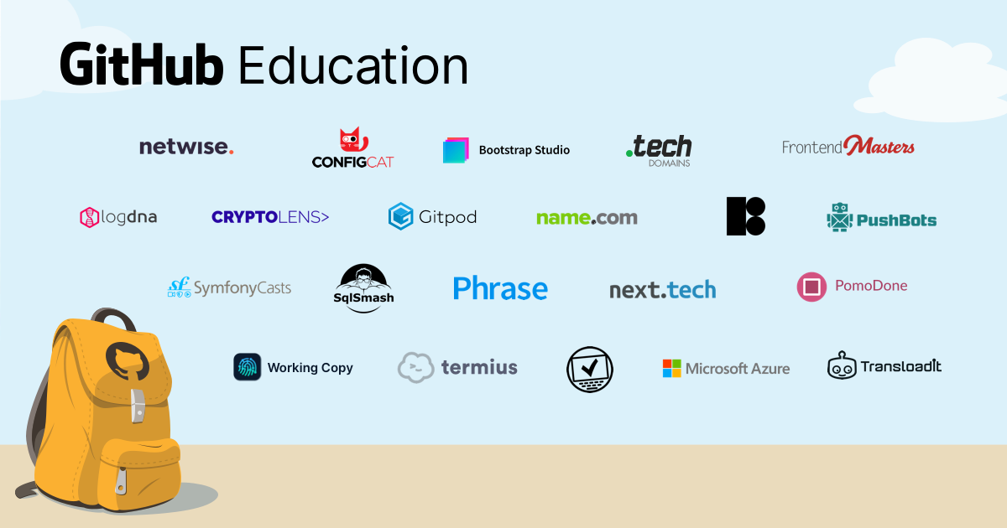

Slide 2
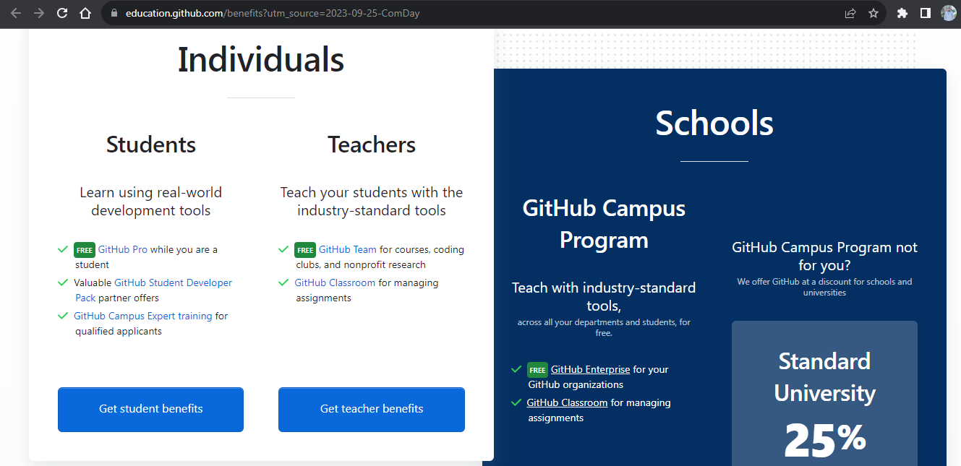

Slide 3
GitHub benefits for all Students!!!
https://gh.io/comday

Slide 4

Hacktoberfest, Git and GitHub
Your path to Open-Source!
Hasham Yonas
hashamyounis9@gmail.com

Slide 5


Slide 6








What is Open Source?
…

Slide 8
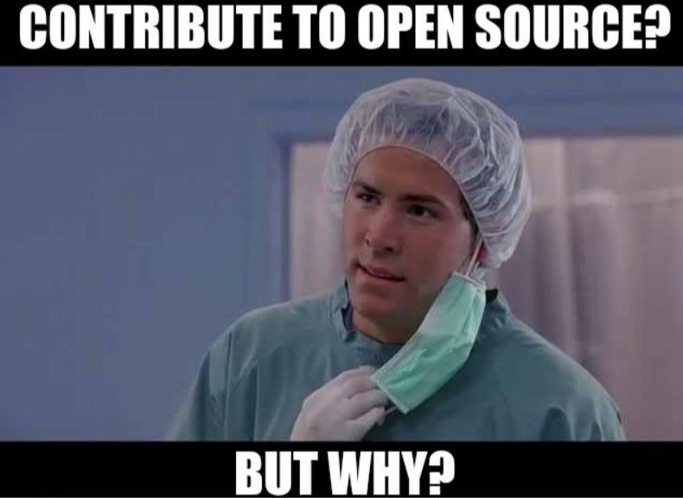

Slide 9
Community Engagement
Skill Development
Portfolio/Resume Enhancement
Mentorship and learning from Experts
And best of all…

Slide 10
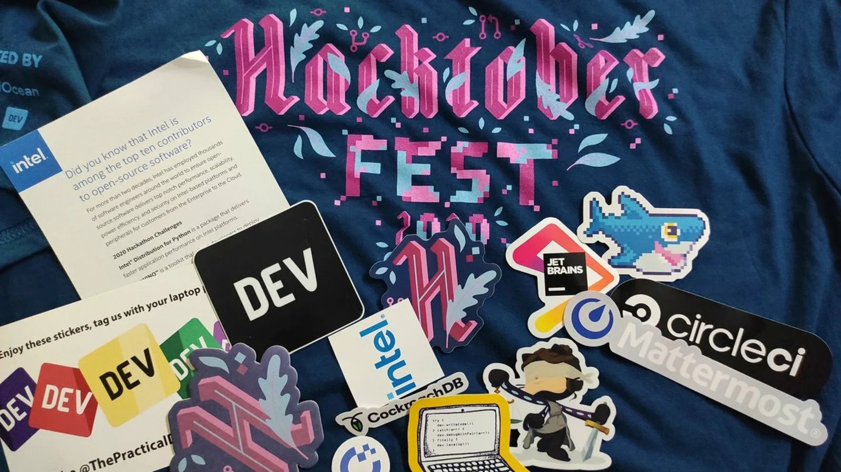

Slide 11
How to take part?
Visit: hacktoberfest.com

Slide 12
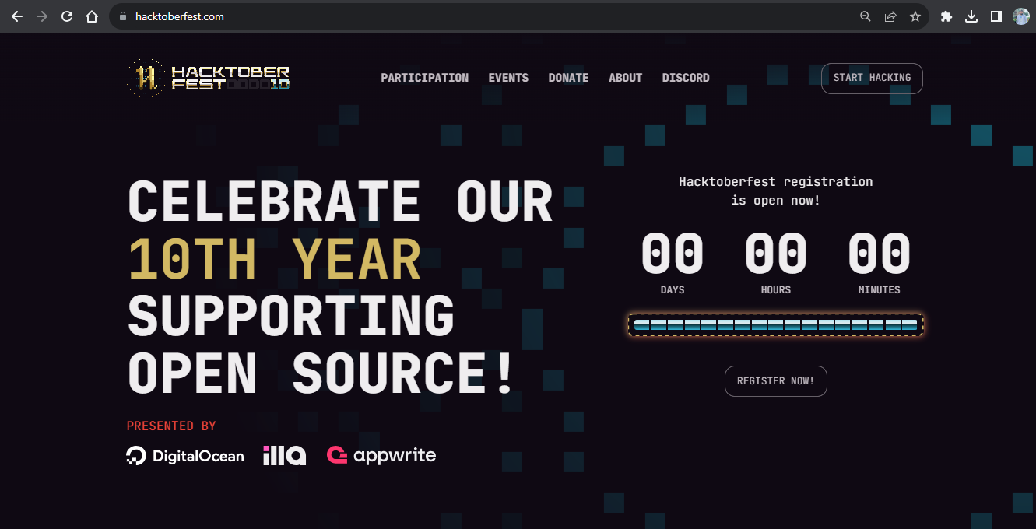

Slide 13
What skills are needed?

Slide 14


Slide 15


Slide 16


Slide 17
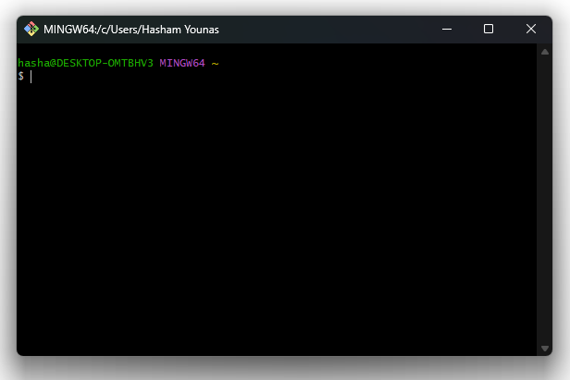

Slide 18
# Most commonly used Git Commands
git init #set a folder as git repository
git status #displays the changes if there were made any
git add #select files to take snapshot
git commit #takes a snapshot of the current version
git push #updates version on github with local version
git branch #create new branch from main/master branch
git merge #add branch back to main/master branch

Slide 19
#version 1.0 can add two numbers (commit)
A = input(“Enter First Number: “)
B = input(“Enter second Number: ”)
print(“Addition is: ”, A+B)

Slide 20
#version 1.1 can add and subtract two numbers
A = input(“Enter First Number: “)
B = input(“Enter second Number: ”)
print(“Addition is: ”, A+B)
print(“Subtraction is: ” A-b) #contains error

Slide 21
#version 1.0 can add two numbers (commit)
A = input(“Enter First Number: “)
B = input(“Enter second Number: ”)
print(“Addition is: ”, A+B)

Slide 22
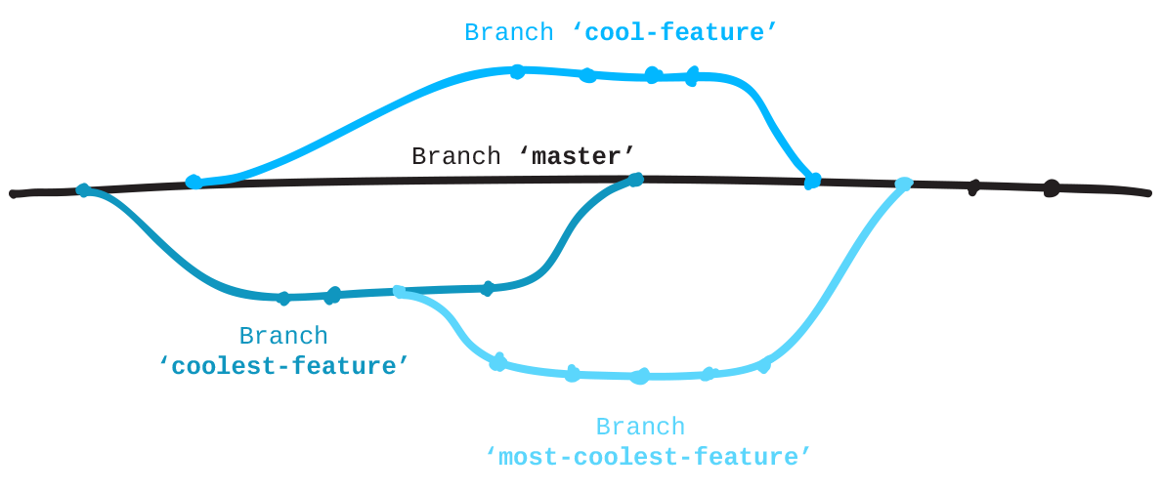

Slide 23
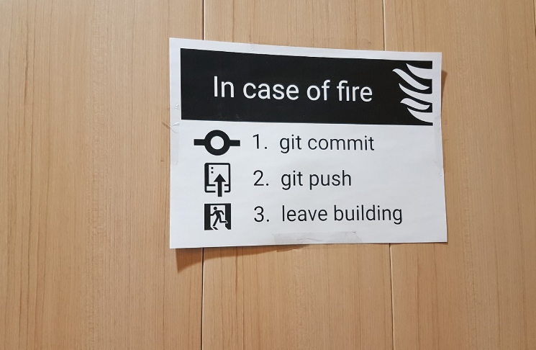

Slide 24


Slide 25
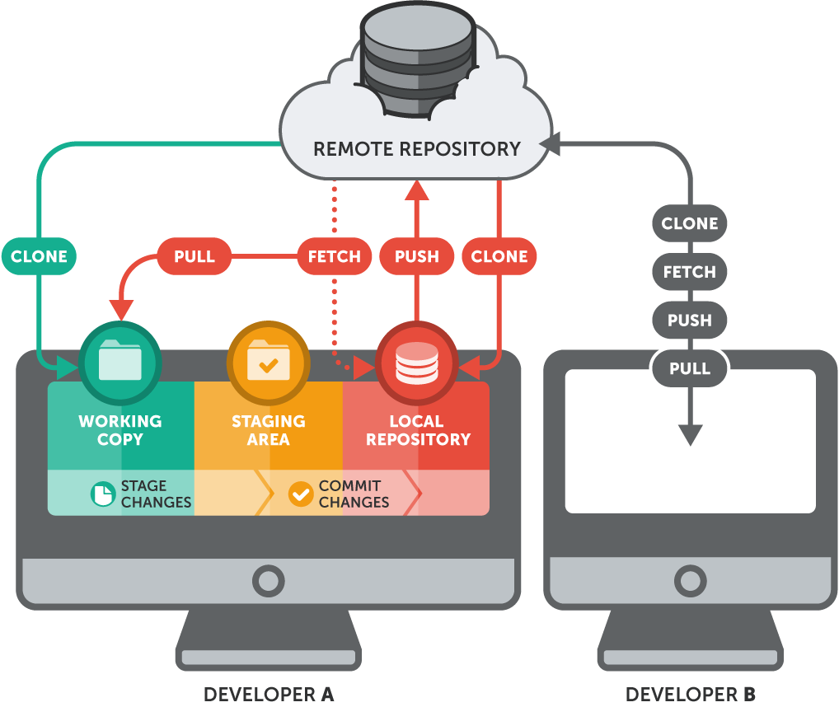

Slide 26
Using GitHub with Git
git clone
git pull
git push
…

Slide 27
Any Questions?

Slide 28
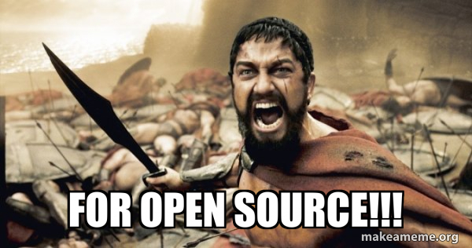

Slide 29
This is GDSC Community Day!

